Slide 1
Hotel Management
Carson Butler,
Ethan Delany,
Dayna Larm

Slide 2
About the Database
Hotels
Staff
Rooms
Customers
Reservations
HOTELS There are multiple hotels. Each hotel has one manager, and every manager must only work for one hotel. Each hotel must have at least one staff member.
SHIFT A Hotel can have multiple shifts. Each individual shift can only be worked by one staff member, but multiple staff members can work a shift at the same time.
STAFF A staff member must work at least one shift, but can work many.

Slide 3
About the Database
Hotels
Staff
Rooms
Customers
Reservations
ROOM A room can only be in one hotel, but a hotel can have multiple rooms. A room can be booked by a reservation on many different occasions, or not at all.
RESERVATION A reservation must have at least one room. Each reservation must only be made by one customer.
CUSTOMER A customer must make at least one reservation, but can make many.
PAYMENT A payment must pay for at least one reservation, but can cover many. Additionally, a reservation must be paid for by one payment, but can be paid for by many

Slide 4
Entity Relationship
Diagram

Slide 5
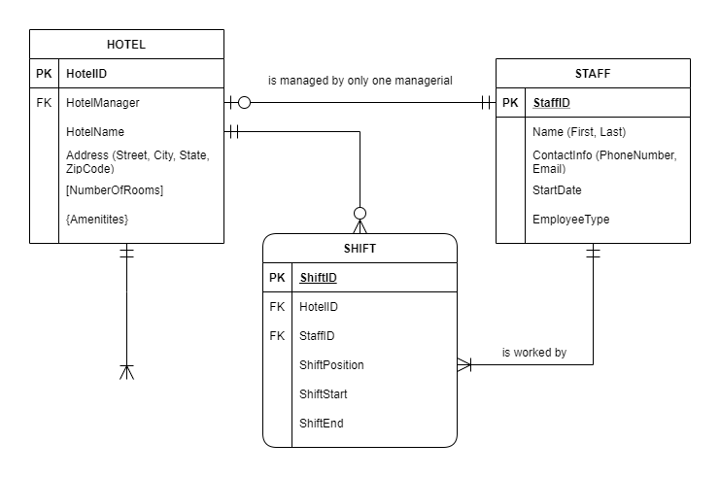

Slide 6
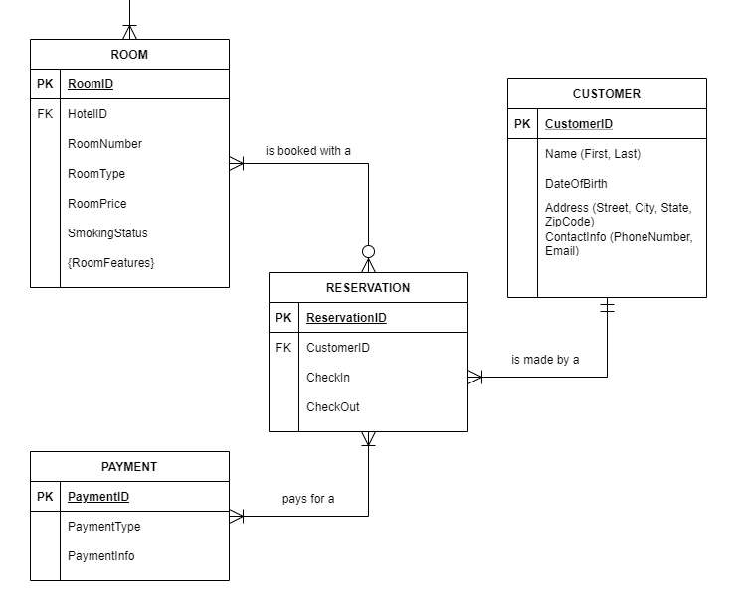

Slide 7
Relational
Model

Slide 8
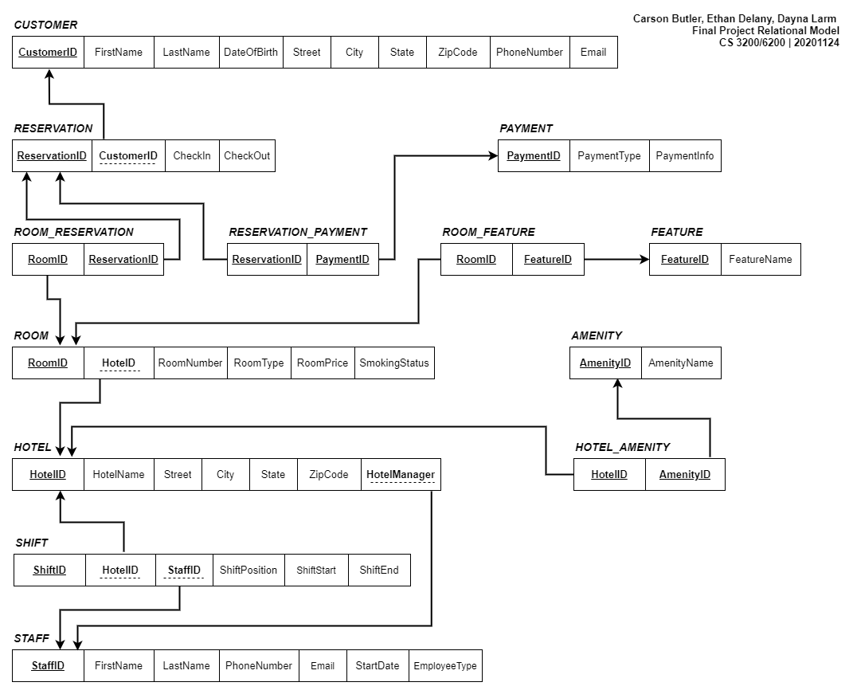
Similar to ERD
Some differences
Associative Entity tables explicitly mapped
ROOM_RESERVATION
Composite Attributes explicitly mapped
CUSTOMER.Address(...)
Multivalued attributes to AE and explicitly mapped
HOTEL.{Amenities}
Derived fields not mapped
HOTEL.[NumberOfRooms]
FK’s now map specific field to specific field
FK’s now explicitly indicate parent/child relationship
FK’s no longer indicate cardinality

Slide 9
MySQL Script
Tables
Constraints
Insert Data

Slide 10
MySQL Queries
Queries
Methods

Slide 11
Working on the Project
Deciphering the Relationships
Designing the Database
Filling in the Gaps
Making Adjustments

Slide 12
Carson Butler,
Ethan Delany,
Dayna Larm

